Slide 1
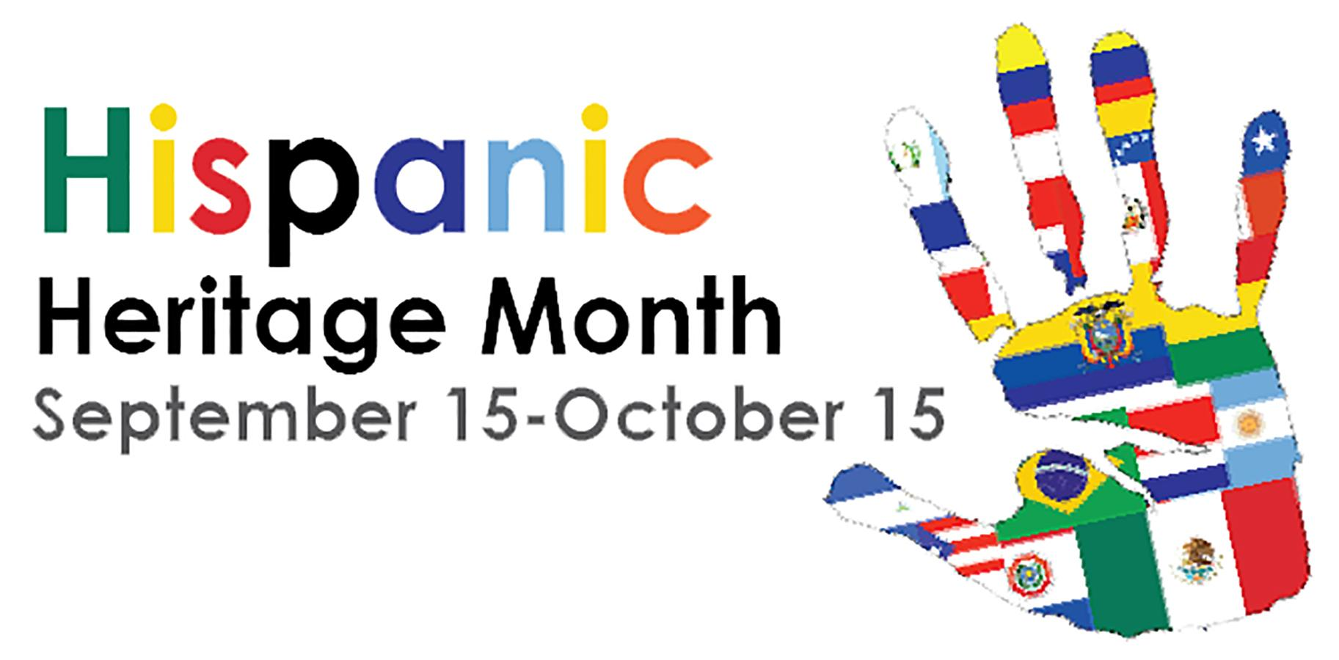

Slide 2
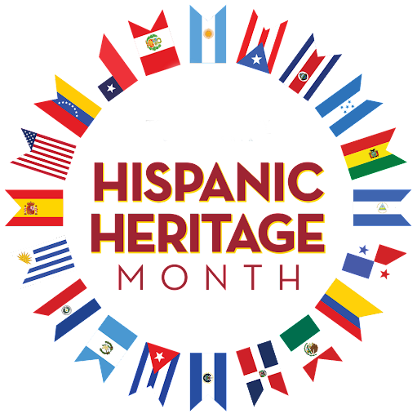
Celebrating Hispanic Heritage
The observation of Hispanic Heritage started in 1968 as just a week long celebration and was extended to a month in 1988. September 15 is a hugely important date as its the independence day celebration for Costa Rica, El Salvador, Guatemala, Honduras and Nicaragua. Mexico and Chile also celebrate their independence day in September. This month is a celebration of latin men and women from across the globe in all areas, from education, sports, government, entertainment, business leaders and so many more.

Slide 3
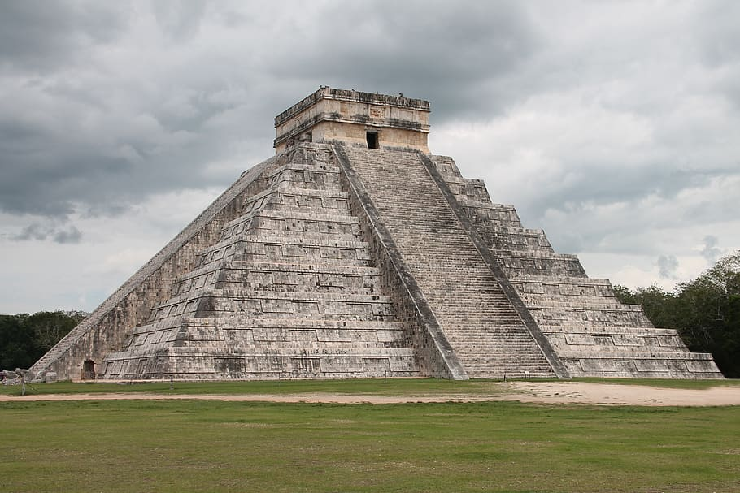
Ancient Civilizations - Central/South America
There were plenty of ancient civilizations in what are now known as Hispanic countries. Three of the major ones are the Mayans, the Aztecs and the Incas.
The Mayans populated countries like Mexico, Honduras, Guatemala, Honduras and Belize and they were known for their knowledge of math, astrology and their architecture.
The Aztecs lived in northern Mexico and their capital city of Tenochitilan is where Mexico City, Mexico’s modern day capital city. The Aztecs also built pyramids and developed agriculture as well as a powerful military might to fight European invaders..
The Inca inhabited the area of ancient Peru but also spanned from Colombia down to Argentina. They built cities in places where even today it would be nearly impossible. Machu Picchu is the architectural masterpiece built by the Incas at the top of the Andes mountains.

Slide 4
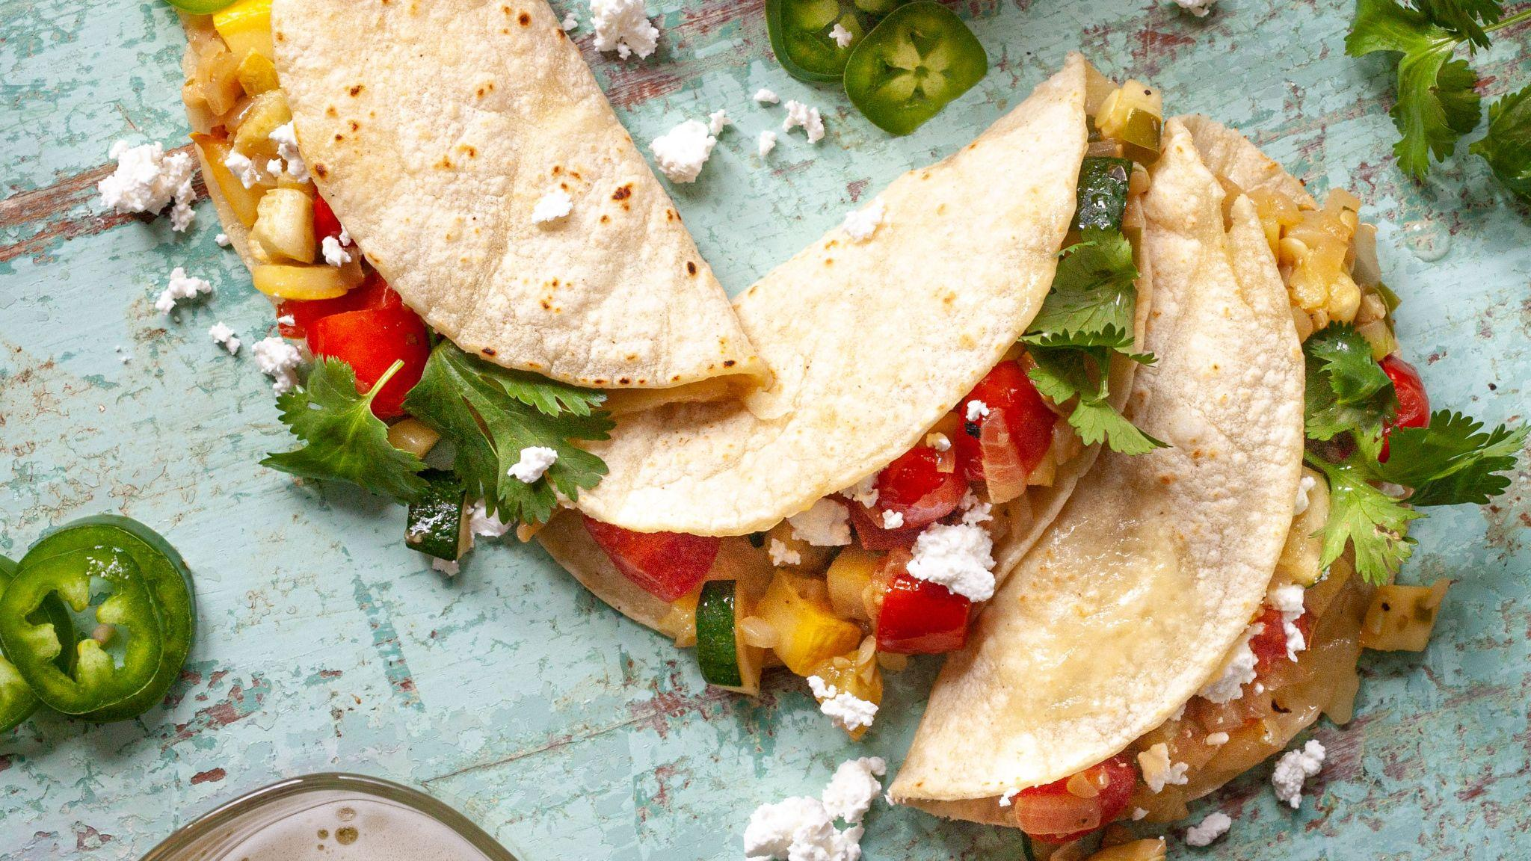
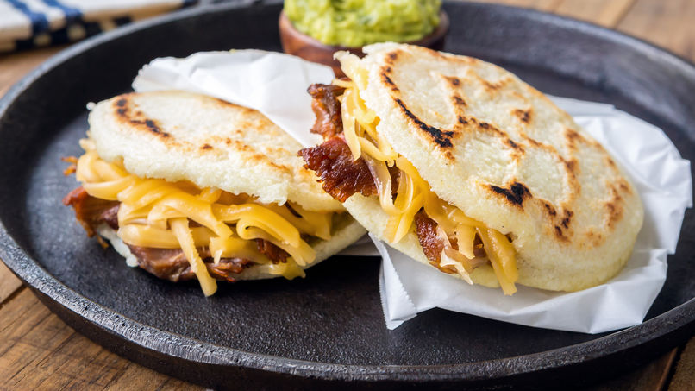
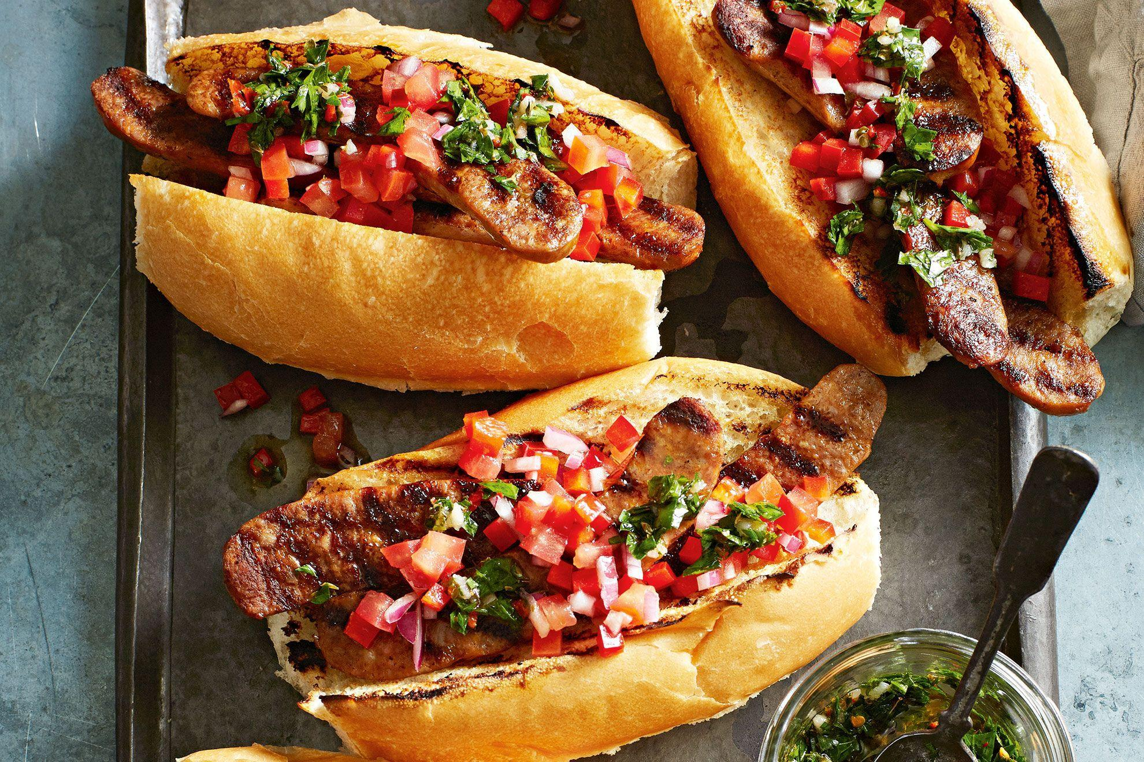
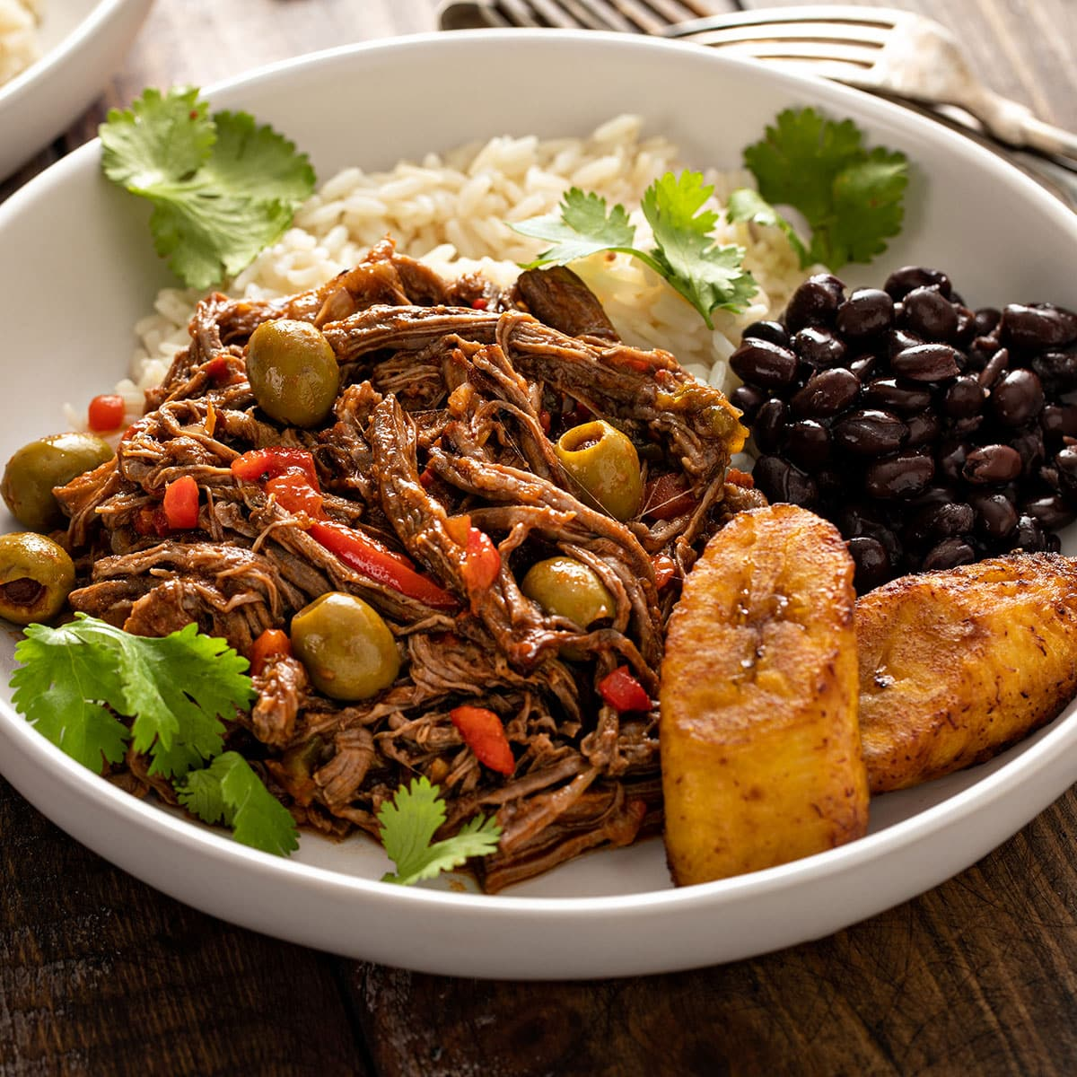
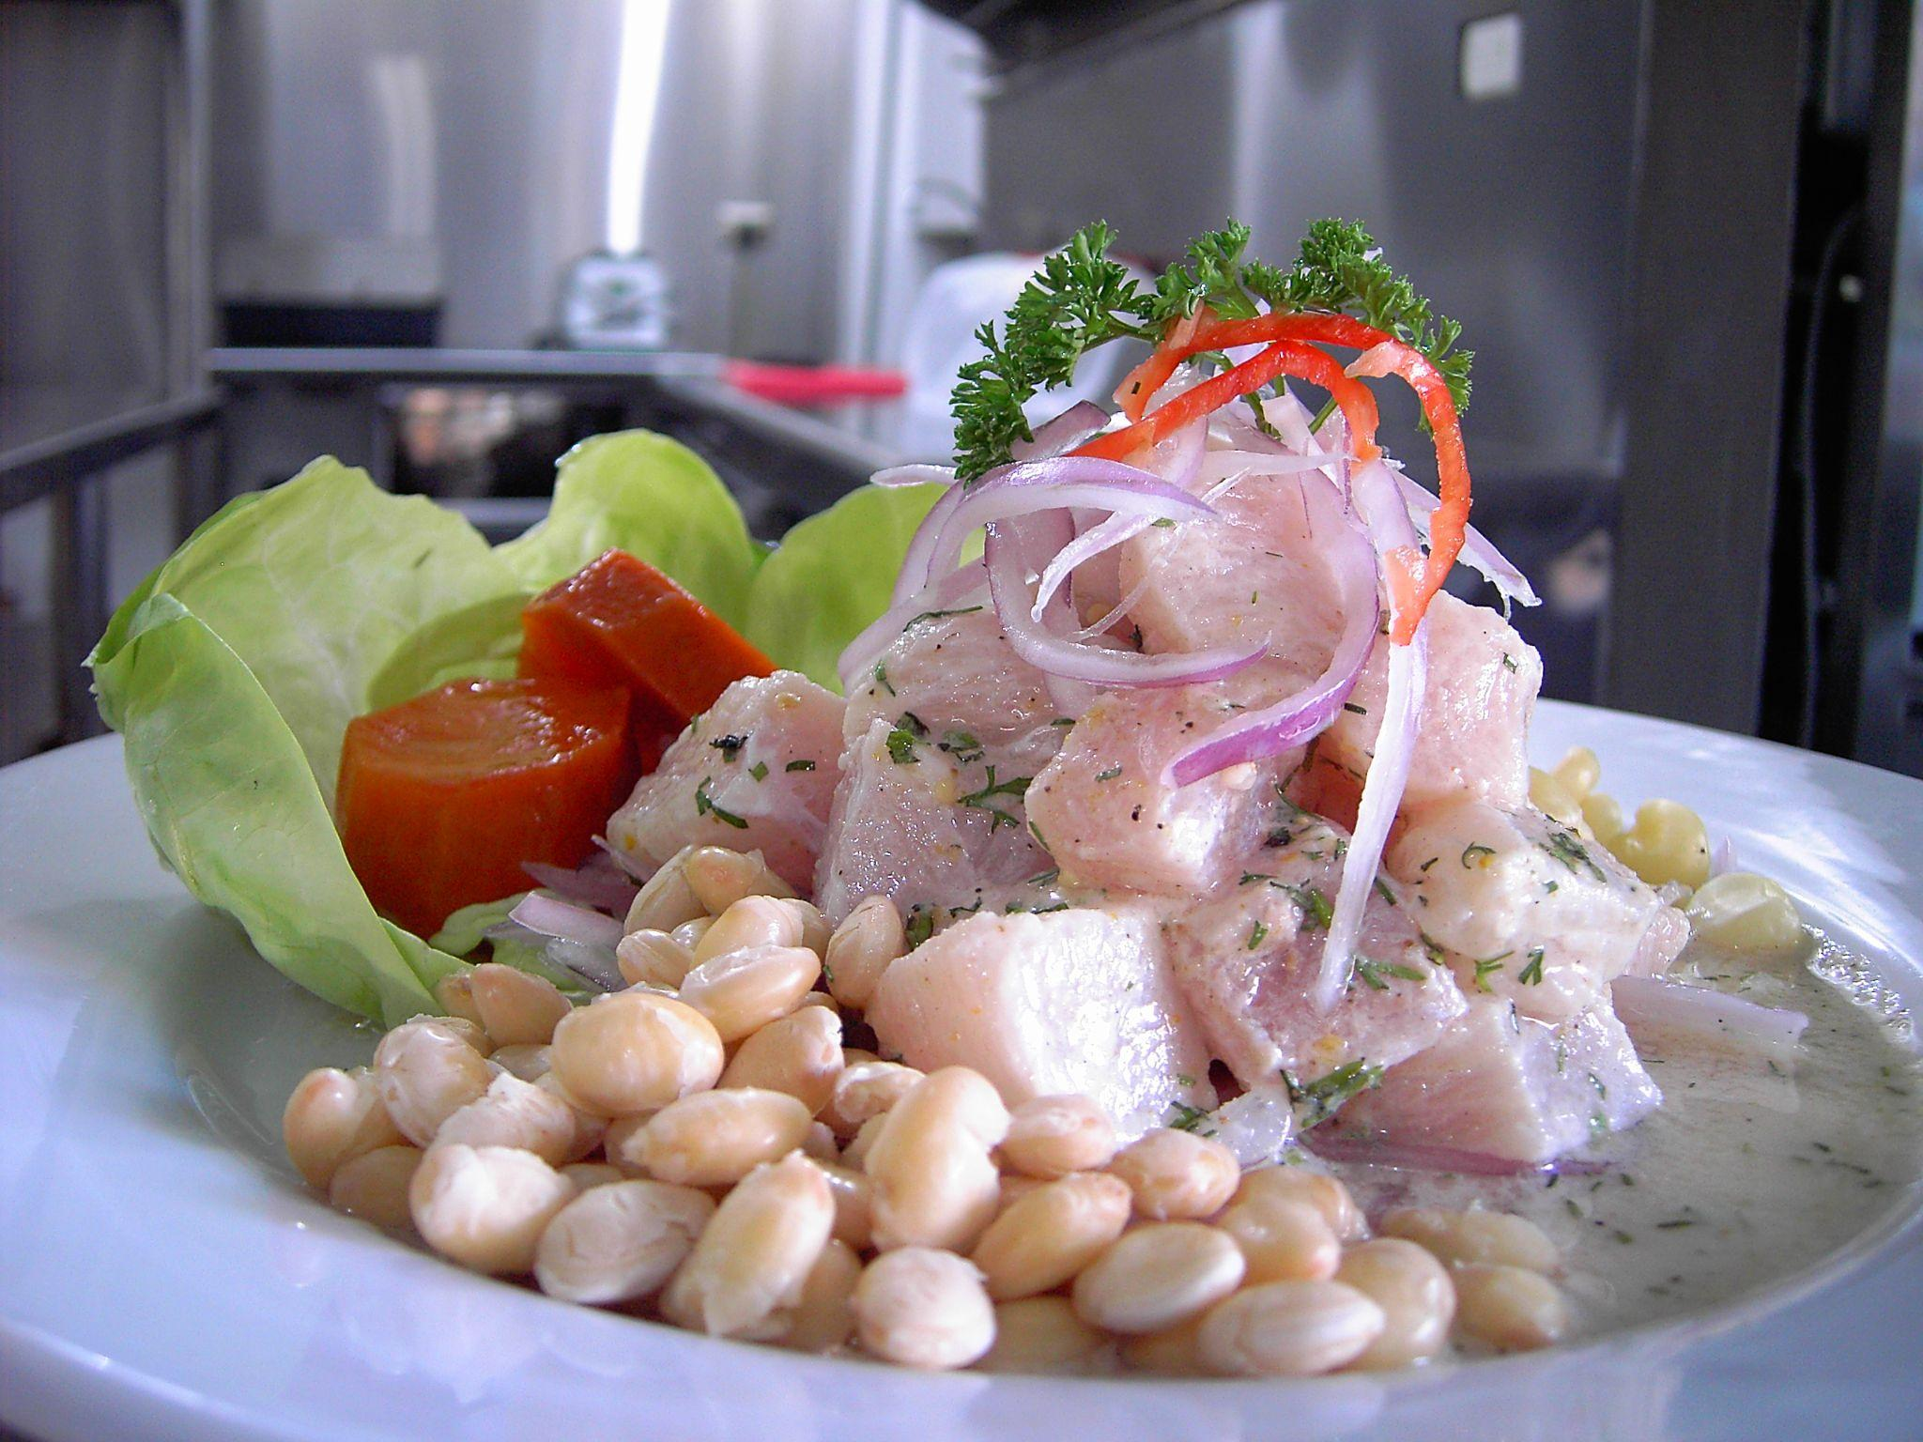
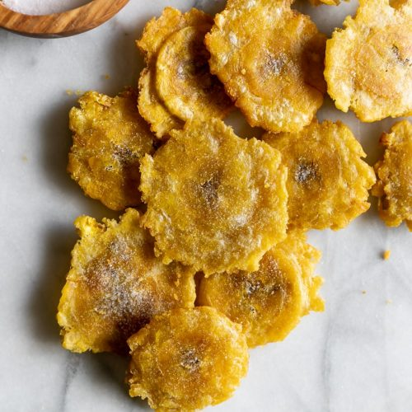
Famous Hispanic Foods!
Tacos - Mexico
Arepas - Colombia/Venezuela
Ropa Vieja - Cuba
Ceviche - Peru
Tostones - Dominican Republic
Choripan - Argentina

Slide 5
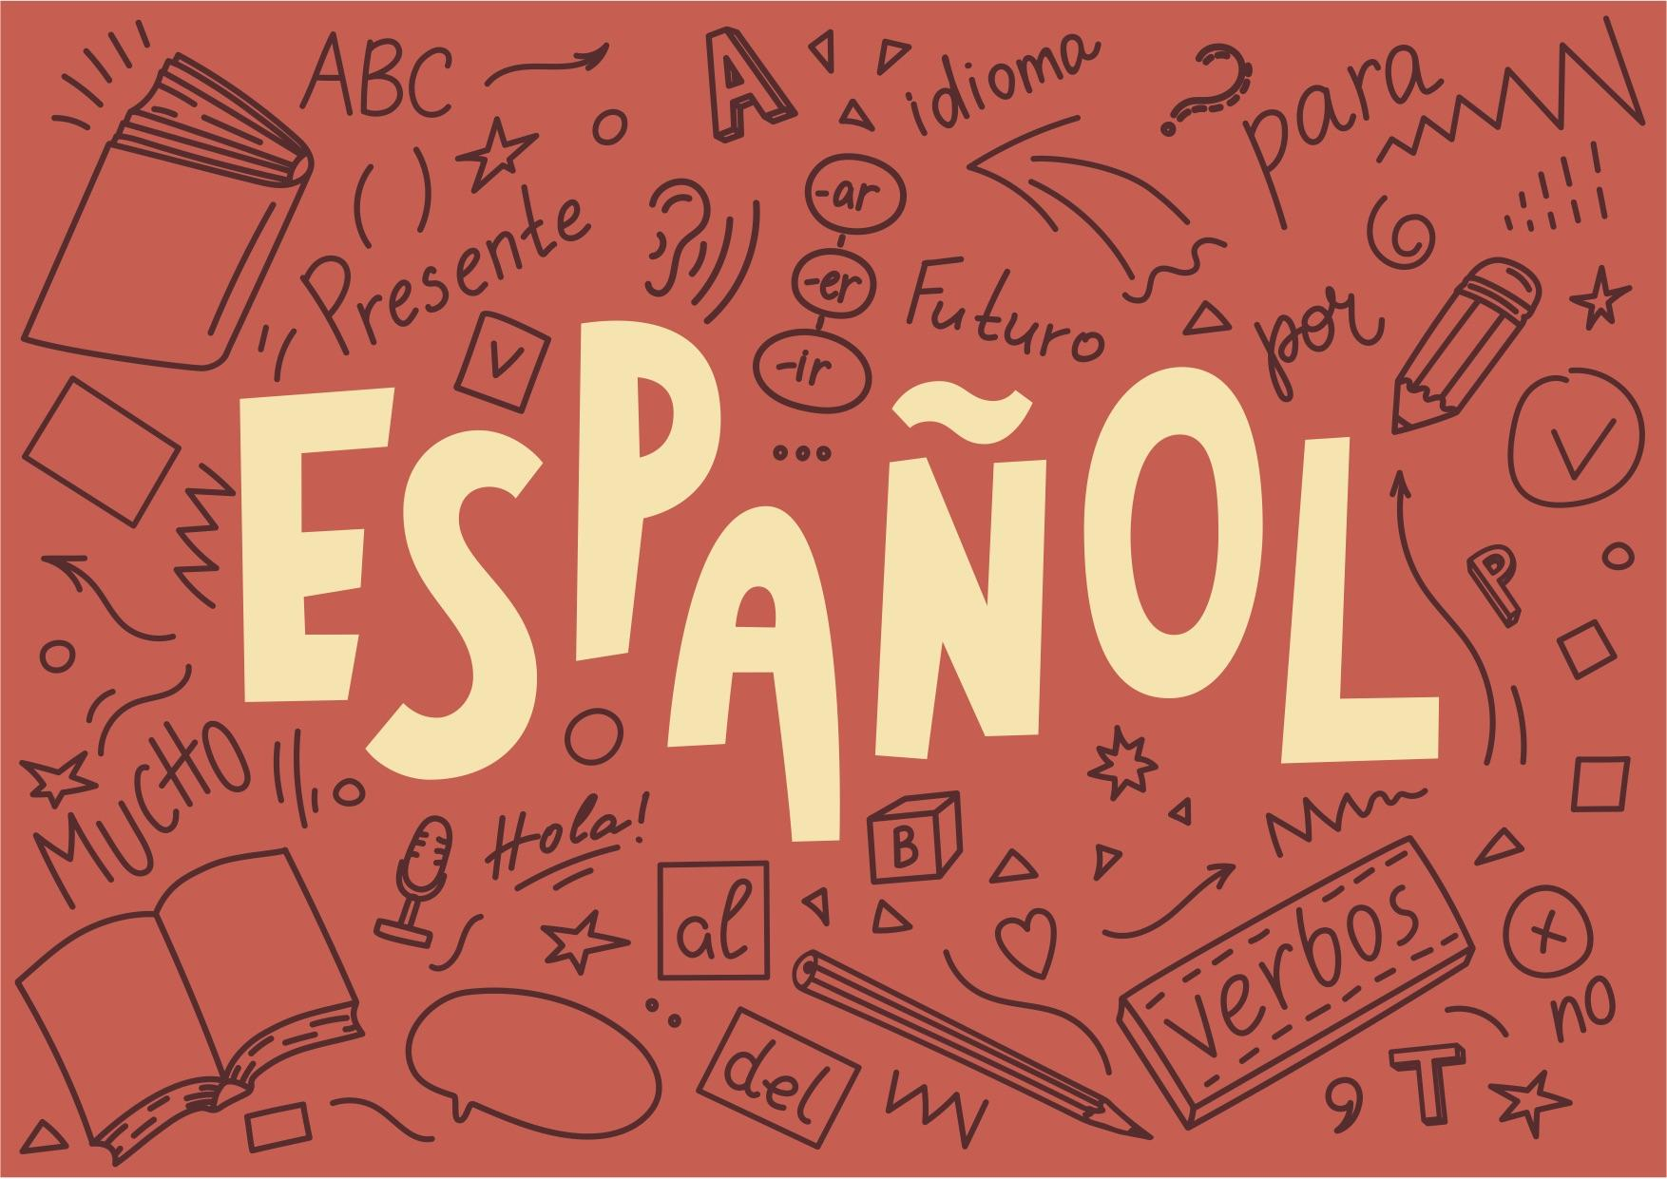
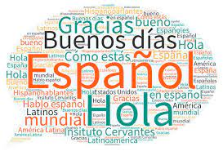
A language of love - Spanish
The language of Spanish is the official language of 22 different countries. There’s over 470 million people who speak Spanish in the world! Spanish can also be referred to as castellano, which is considered to be a more proper form of the language just like the Queen’s English in England. Each Spanish speaking country has its own version of the language with different dialects and slangs but someone from Mexico can understand someone from Uruguay just the same.

Slide 6
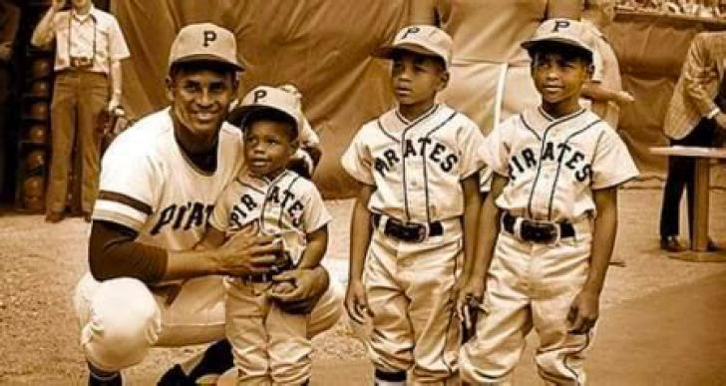
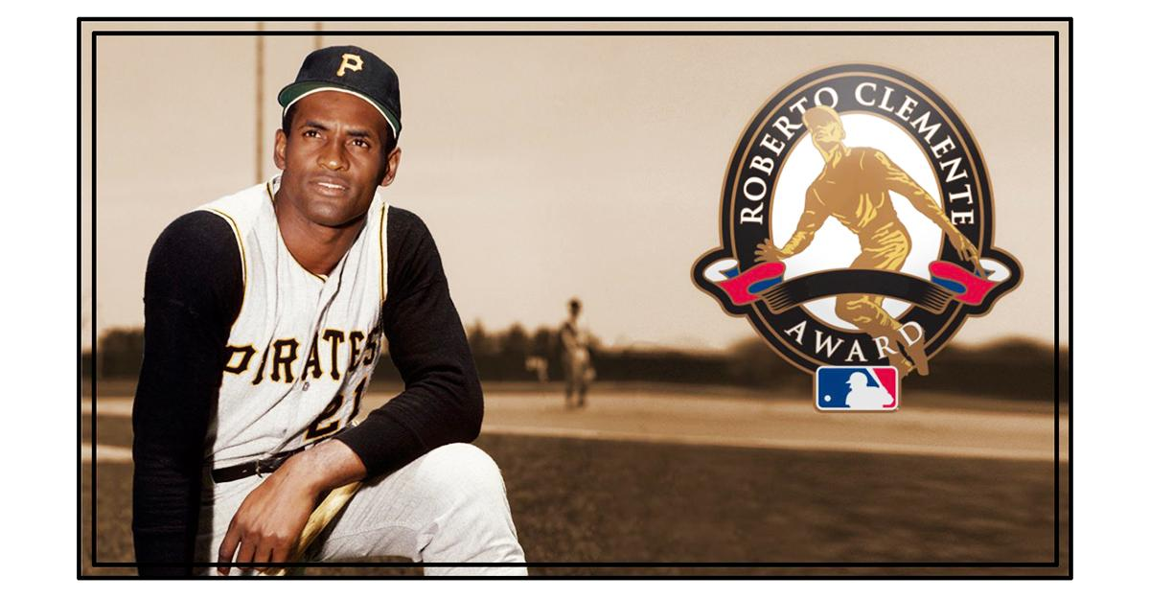
Roberto Clemente
Roberto Clemente was a Puerto Rican born professional baseball player, however, he was much more than just a Hall of Fame player. Clemente was the hispanic version of Jackie Robinson; Robinson broke the color barrier in the Major Leagues and Clemente broke that same barrier for hispanic/latino born players. Roberto was the first Latin American player inducted into the prestigious National Baseball Hall of Fame after tragically losing his life in a plane crash on his way to Nicaragua which was hit by a devastating earthquake in 1972. Clemente is a true hero in every sense of the word both on and especially off the diamond.

